Slide 1
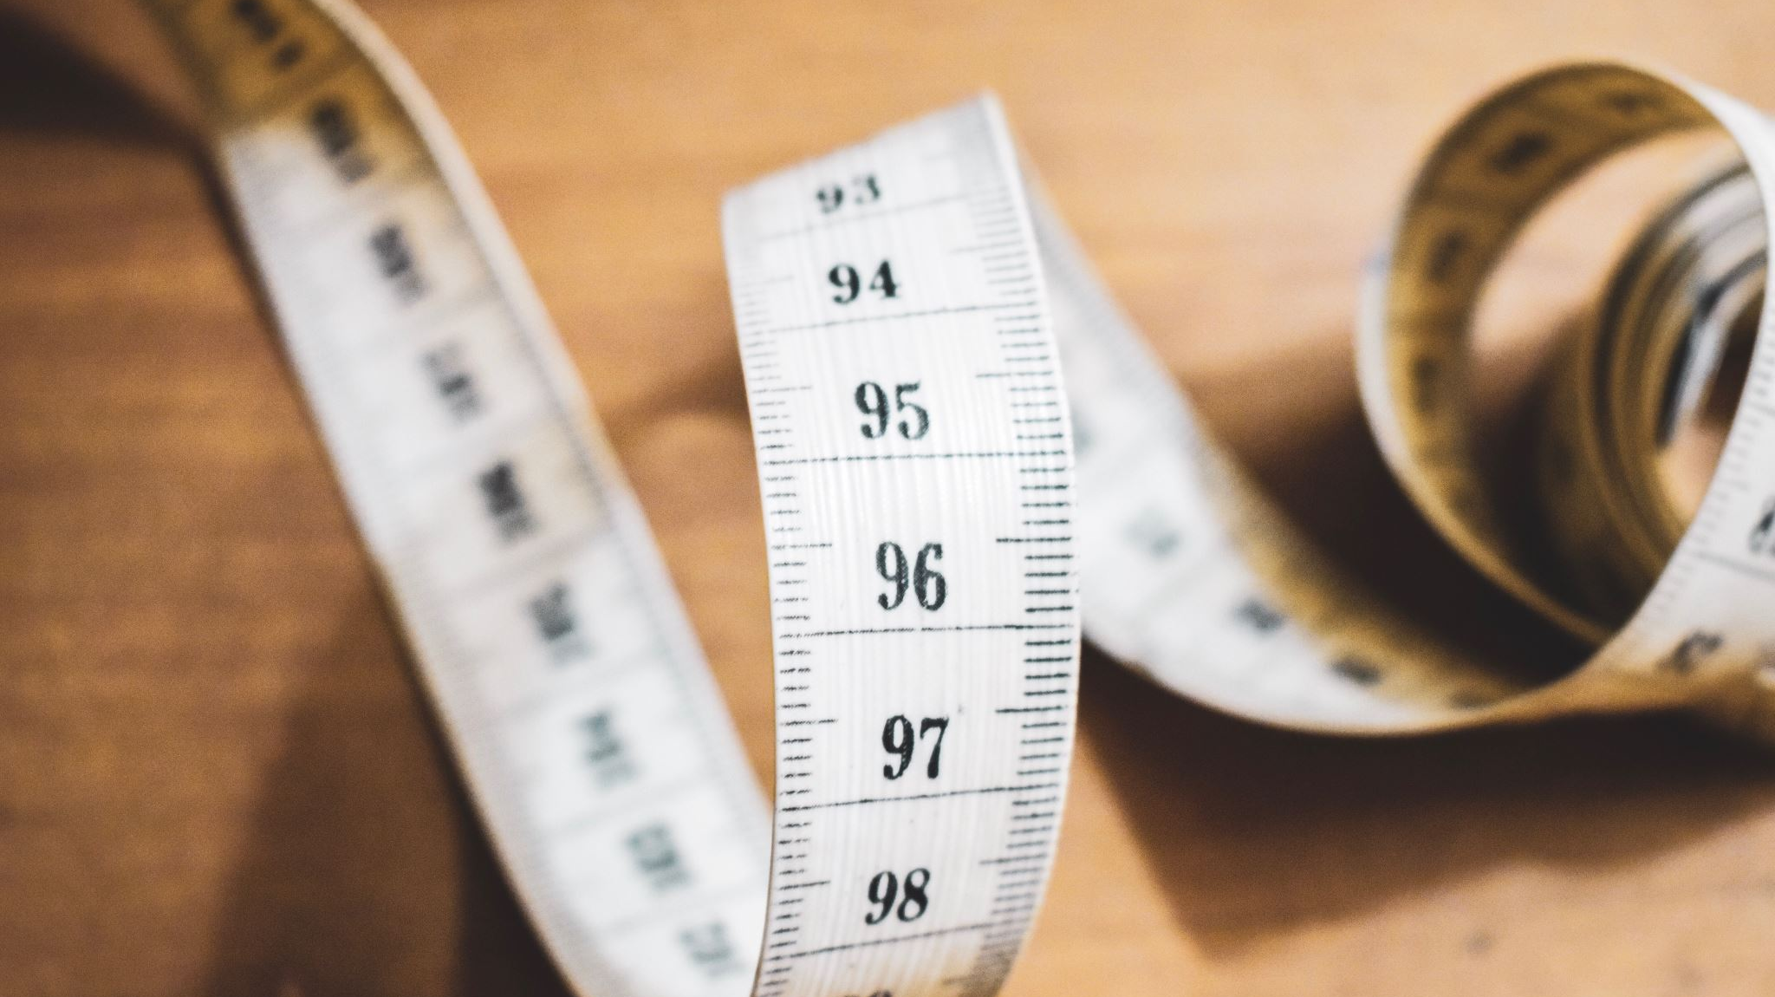
Obesity Levels Analysis
Exploratory Data Analysis , Classification and Clustering Project
Made by : Marwan Tamer

Slide 2
Outline:
Overview
Explore Data
Preprocessing
Classification Models
Generalize the Clusters
Dashboards

Slide 3
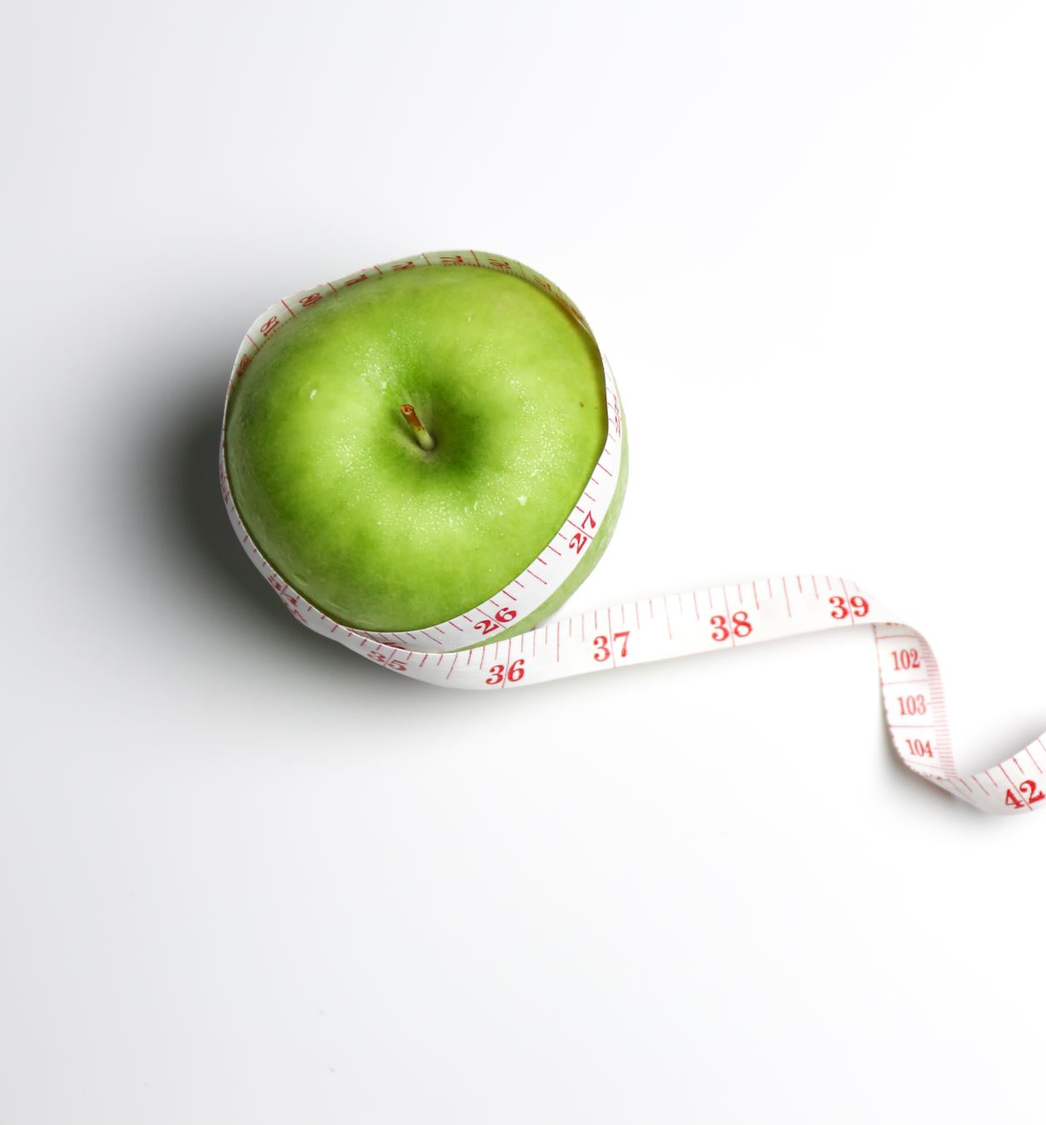
Overview :
This dataset estimates obesity levels based on eating habits and physical condition.
It includes 2111 records with 17 attributes from individuals in Mexico, Peru, and Colombia
The target variable is NObesity (Obesity Level) with classes:
Insufficient Weight
Normal Weight
Overweight Level I & II
Obesity Type I, II, III
Data Source:
23% real data collected via a web platform
77% synthetic data generated using Weka SMOTE

Slide 4
Explore Data
This dataset includes key lifestyle and health features:
Family History with Overweight: Has a family member suffered or suffers from overweight? FAVC: Do you eat high caloric food frequently? FCVC: Do you usually eat vegetables in your meals? NCP: How many main meals do you have daily? CAEC: Do you eat any food between meals? SMOKE: Do you smoke? CH2O: How much water do you drink daily? SCC: Do you monitor the calories you eat daily? FAF: How often do you have physical activity? TUE: How much time do you use technological devices (e.g. phone, TV, computer)? CALC: How often do you drink alcohol? MTRANS: Which transportation do you usually use?

Slide 5

Preprocessing
Transformation: I performed data type transformations for some columns to prepare them for encoding and scaling.
Ordinal Encoding: I applied ordinal encoding to convert categorical variables with ordered categories into numerical values suitable for modeling.
Robust Scaler: I used Robust Scaler on numerical features because the data contained meaningful outlier values, and Robust Scaler is less sensitive to outliers compared to standard scaling methods.

Slide 6
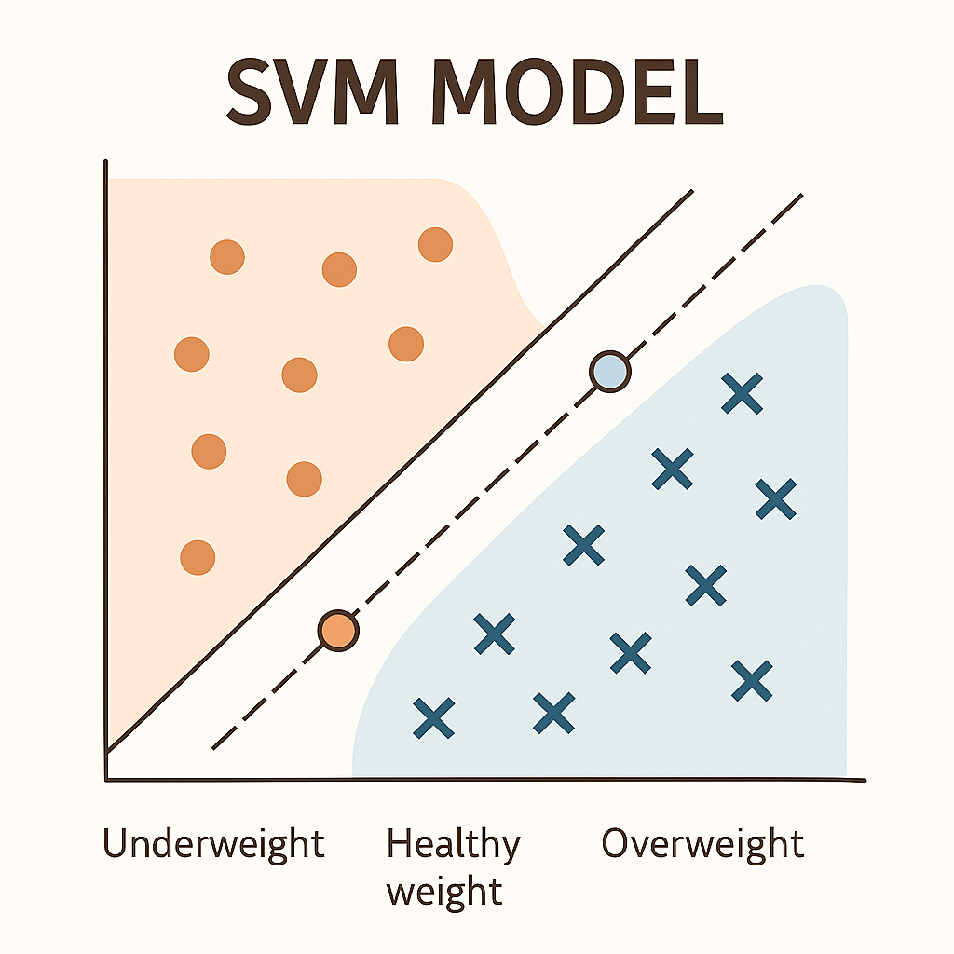
Classification Models
Tested several classification models, including:
Random Forest
Support Vector Machine (SVM)
K-Nearest Neighbors (KNN)
Logistic Regression
Chosen Model: I selected SVM because it provided better generalization performance compared to other models.
Overall Accuracy: 90%

Slide 7
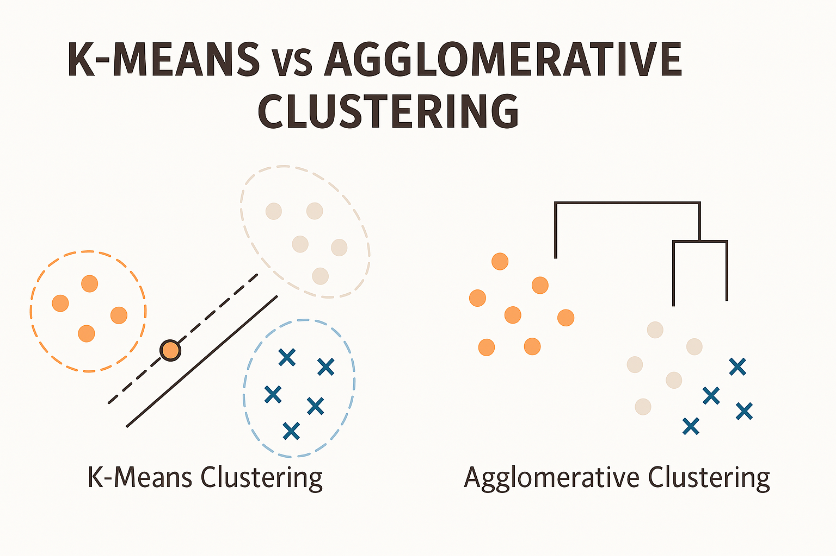
Clustering Phase
Tested two clustering algorithms to analyze the obesity data patterns:
K-Means Clustering
Agglomerative Clustering
Chosen Algorithm: I selected K-Means because it achieved a better silhouette score

Slide 8
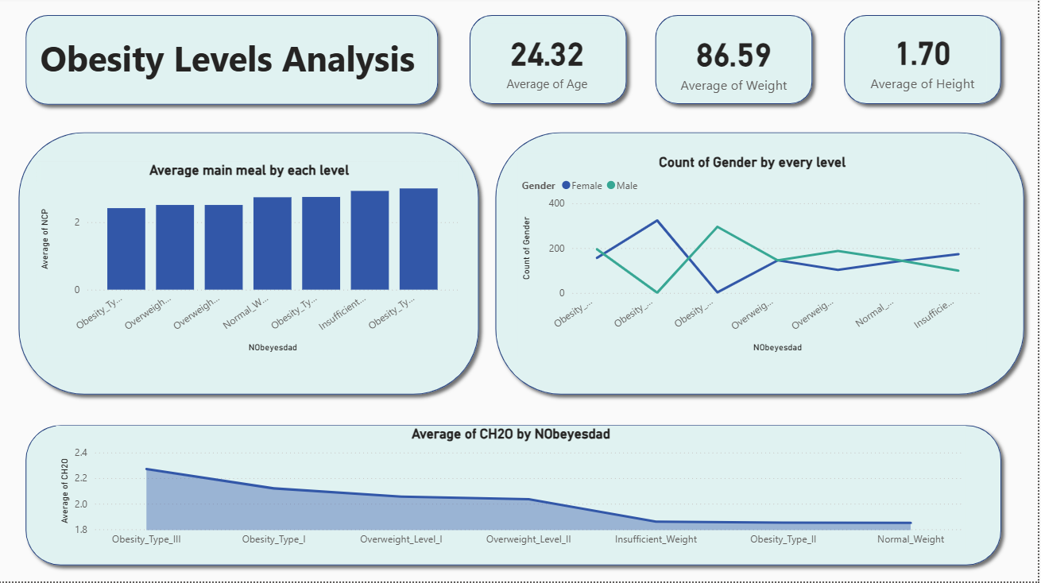
Dashboard :

Slide 9
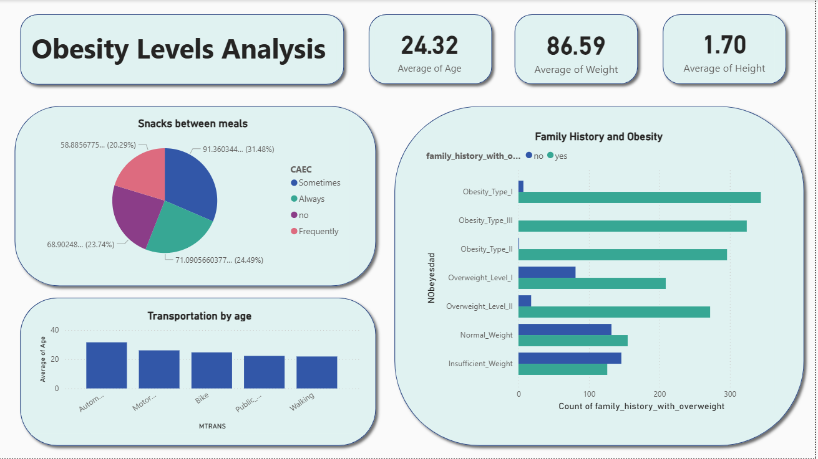
Con. Dashboard

